Slide 1
Smith-Waterman Algorithm for Sequence Alignment
Dr. Muhammad Tahir
Assistant Professor
COMSATS University Islamabad,
Attock Campus

Slide 2
Smith-Waterman Algorithm Advances in Applied Mathematics, 2:482-489 (1981)
The Smith-Waterman algorithm is a local alignment tool used to obtain sensitive pairwise similarity alignments.
Smith-Waterman algorithm uses dynamic programming.
Operating via a matrix, the algorithm uses backtracing and tests alternative paths to the highest scoring alignments, and selects the optimal path as the highest ranked alignment.
The sensitivity of the Smith-Waterman algorithm makes it useful for finding local areas of similarity between sequences that are too dissimilar for alignment.
The S-W algorithm uses a lot of computer memory.
BLAST and FASTA are other search algorithms that use some aspects of S-W.

Slide 3
Smith-Waterman (cont. 1)
It searches for both full and partial sequence matches.
Assigns a score to each pair of amino acids
-uses similarity scores
-uses positive scores for related residues
-uses negative scores for substitutions and gaps
c). Initializes edges of the matrix with zeros
d. As the scores are summed in the matrix, any sum below 0 is
recorded as a zero.
e. Begins backtracing at the maximum value found anywhere in the matrix.
f. Continues the backtrace until the score falls to 0.

Slide 4
Smith-Waterman (Steps)
The basic steps for the algorithm are similar to that of Needleman-Wunsch algorithm.
The steps are:
1. Initialization of a matrix. 2. Matrix Filling with the appropriate scores. 3. Trace back the sequences for a suitable alignment.

Slide 5

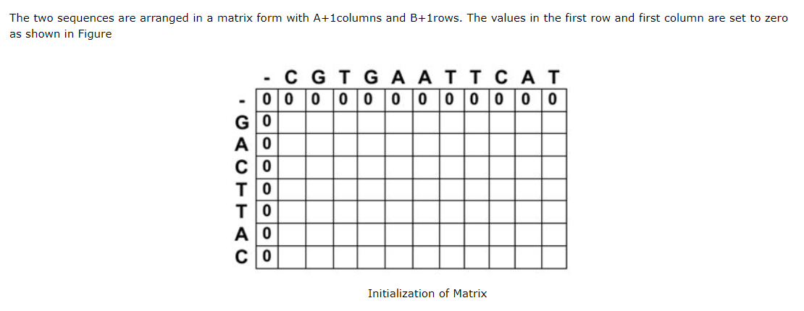
Smith-Waterman (Step 1)

Slide 6
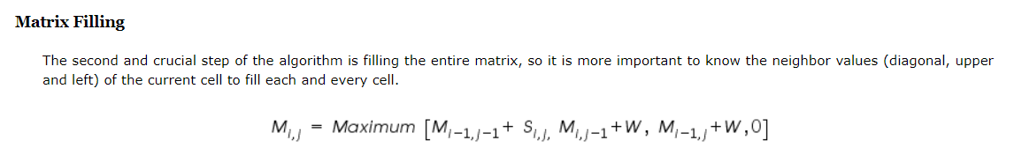
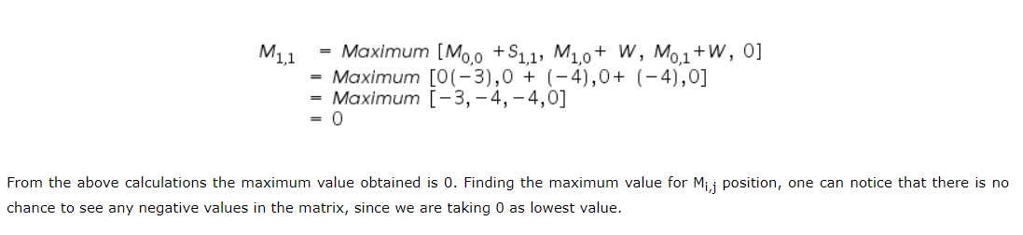
Smith-Waterman (Step 2)

Slide 7
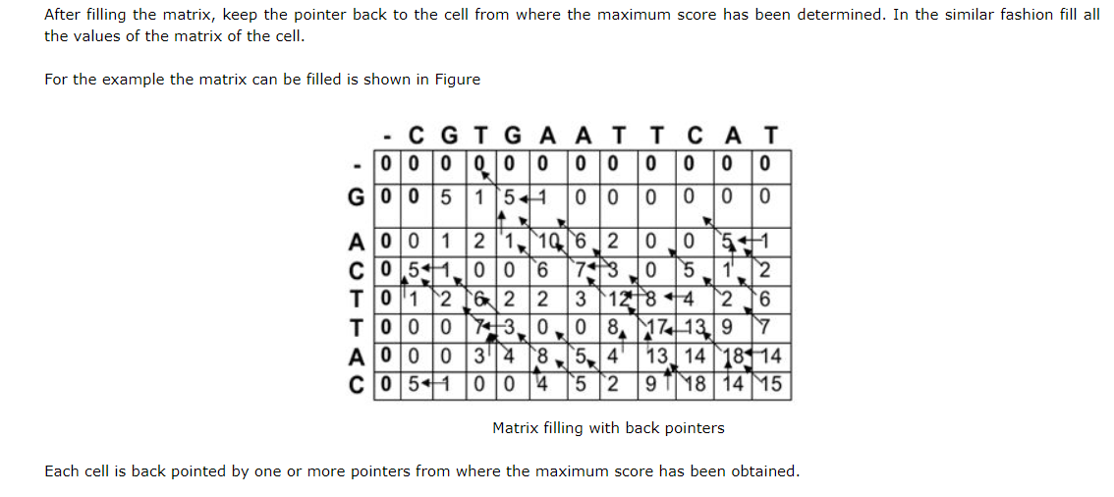
Smith-Waterman (Step 3)

Slide 8
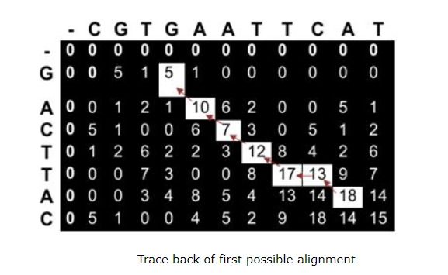
Smith-Waterman (Step 3 cont)
Selecting Optimal Alignment

Slide 9
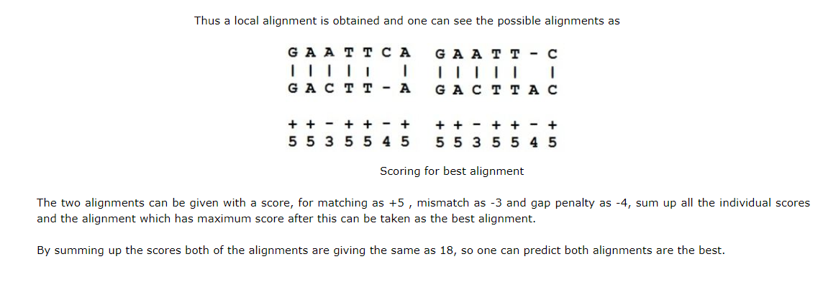
Smith-Waterman (Step 3 cont)

Slide 10
Smith-Waterman (Example. 2)
H E A G A W G H E E
Put zeros on
borders. Assign initial scores
based on a scoring
matrix. Calculate new scores based on
adjacent cell scores.
If sum is less than
zero or equal to zero
begin new scoring
with next cell.
P
A
W
H
E
A
E
0 0 0 0 0 0 0 0 0 0 0
0 0 0 0 0 0 0 0 0 0 0
0 0 0 5 0 5 0 0 0 0 0
0 0 0 0 3 0 2012 4 0 0
0 10 2 0 0 0 12182214 6
0 2 16 8 0 0 4101828 20
0 0 82113 5 0 41020 27
0 0 6131812 4 0 416 26
This example uses the BLOSUM45 Scoring Matrix with a gap extension
penalty of -3

Slide 11
Smith-Waterman (cont. 3)
H E A G A W G H E E
P
A
W
H
E
A
E
0 0 0 0 0 0 0 0 0 0 0
0 0 0 0 0 0 0 0 0 0 0
0 0 0 5 0 5 0 0 0 0 0
0 0 0 0 3 0 2012 4 0 0
0 10 2 0 0 0 12182214 6
0 2 16 8 0 0 4101828 20
0 0 82113 5 0 41020 27
0 0 6131812 4 0 416 26
Begin backtrace at the
maximum value found
anywhere on the matrix.
Continue the backtrace
until score falls to zero
AWGHE
|| ||
AW-HE
Path Score=28

Slide 12
Calculation of percent similarity
A W G H E
A W - H E
5 15 -5 10 6
Blosum 45 SCORES
-3
GAP EXT. PENALTY
% SIMILARITY =
NUMBER OF POS. SCORES
DIVIDED BY NUMBER OF AAs
IN REGION x 100
% SIMILARITY = 4/5 x 100
= 80%

Slide 13
Scoring Matrix
BLOSUM and PAM
BLOSUM62 ~~ PAM250
Higher number in BLOSUM Lower number is PAM ➔ Deals with MORE close homologue sequences
So if you want to find more distantly related homologue, use BLOSUM 50 or lower instead of BLOSUM62

Slide 14
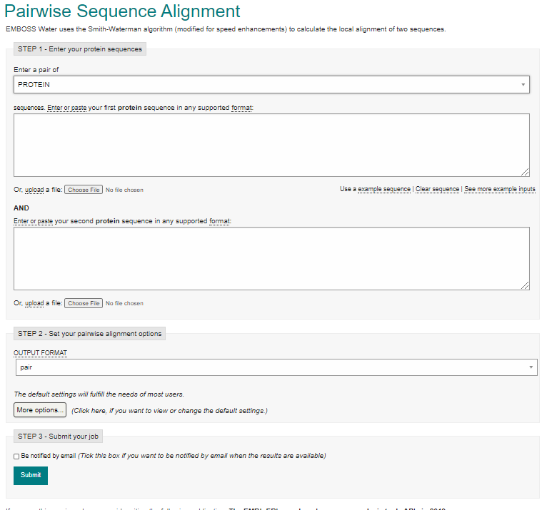
Link: https://www.ebi.ac.uk/Tools/psa/emboss_water/

